Slide 1
Advance Database System
Image Encryption and Decryption

Slide 2
INTRODUCTION
In recent years, with the rapid development of computer technology, digital image processing technology has also rapidly developed and penetrated into all aspects of life, such as remote sensing,industrial detection, medicine, meteorology, communication, investigation, intelligent robots, etc.
Cryptography, as name suggests, is generally study of methods like encryption. Its main objective is to provide methods simply to secure and protect information and communications using encryption and related techniques. It simply allows one to store sensitive information or transmit it across insecure networks so that it cannot be read or accessed by anyone except intended recipient. Its functions include authentication, nonrepudiation, confidentiality and integrity.
We have used SHA-512 algorithm for image encryption. The main idea of the algorithm is to use one half of image data for encryption of the other half of the image reciprocally.

Slide 3
CHALLENGES
Despite being computationally demanding, cryptographic techniques have facilitated solutions to a variety of security issues in image and video processing. Even though the different applications come with different challenges, it is clear that the signal processing community will have to face three main challenges in future work.
First, the utility and limitations of cryptography are not very well known to the community, which hampers the widespread consideration of cryptographic solutions for security problems in image and video processing.
Second, cryptographic operations are often computationally expensive. Efficient usage of cryptographic protocols is therefore imperative.
And third, certain cryptographic techniques cause ciphertext expansion of two orders of magnitude, such as public-key encryption of image pixels. Efficient data packing strategies and operations are then needed.

Slide 4
METHODOLOGY
The main idea of the algorithm is to use one half of image data for encryption of the other half of the image reciprocally. Distinct characteristics of the algorithm are high security, high sensitivity and high speed that can be applied for encryption of gray-level and color images. The algorithm consists of two main sections: The first does preprocessing operation to shuffle one half of image. The second uses hash function to generate a random number mask. The mask is then XORed with the other.

Slide 5
STEP-WISE IMPLEMENTATION FOR IMAGE ENCRYPTION:
Generate a SHA-based hash string of the user password.
Convert the hash into {8 x 64} binary matrix, SHA-512 is used.This step forms the initial key expansion.
Resize this matrix to ﬁt into the image binary matrix, this is denotes as, λ_{8,MN} where M ,N are the original image dimensions.
Feed the result into a compound transform, DCT followed by FFT with some constraints.
XOR the result with the image bit stream.
Generate a new randomized binary Map of size (M x N ) for the post-processing step (pixel substitution).
Encrypted image.

Slide 6


Slide 7
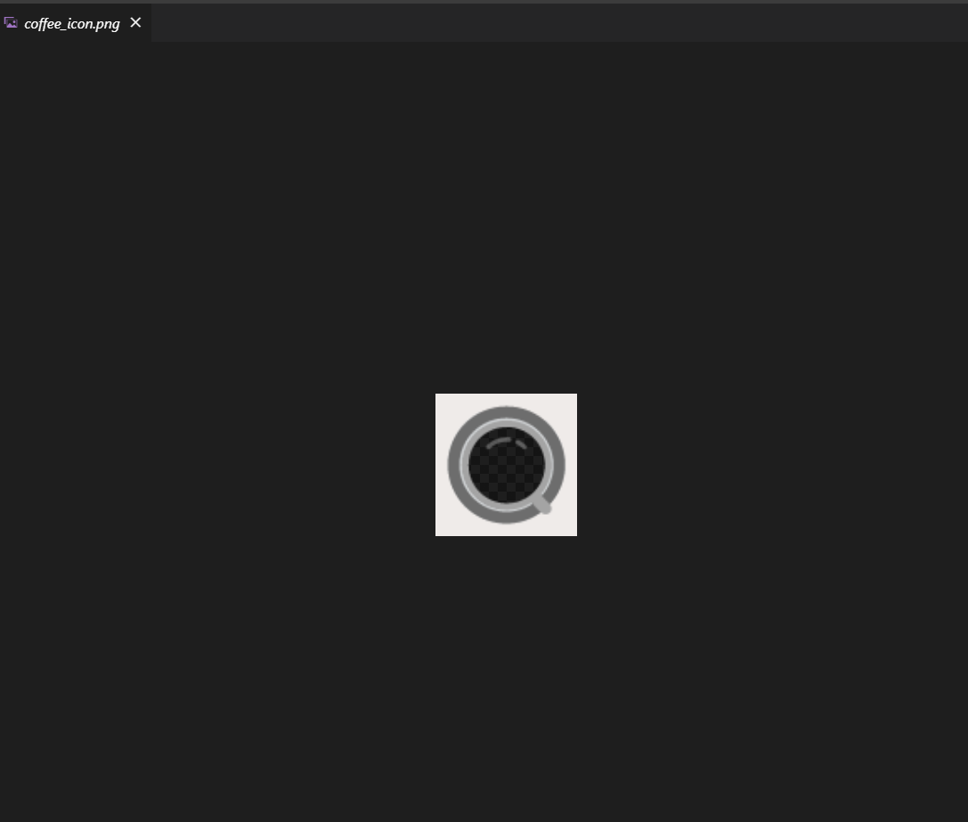
Here is our sample image coffee_icon which we will encrypt:

Slide 8

Here is our decrypt algorithm which is used to decrypt the image with the password which we have entered while executing encryption.py:

Slide 9

RESULT

Slide 10
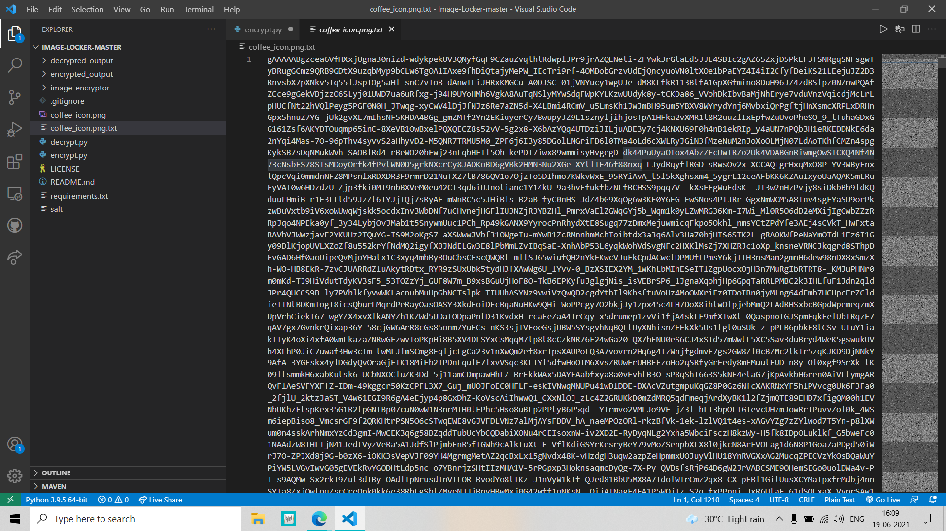
When prompted for password, we enter the password which creates the encrypted .txt file as shown:

Slide 11


Now we run decrypt.py:
When asked for password, we enter the password which decrypts the image and stores it it in our project folder:
Decrypted image.

Slide 12
CONCLUSION
An image compression and encryption based algorithm for high speed and secure transmission of digital image while passing through the web. So the proposed work is highly achieved as needed for speed and security .This proposed work is to work with color images without losing color and detailed information in image ,this work is very useful to the modern digital world. Experimental results say that the proposed scheme is effective, secure and robust to compress, encrypt and decompress-decrypt images.

